Slide 1
Final Project - seq2seq
Mica Haney
Bailu Zhang
Tam Doan

Slide 2
Data
The text used is the introduction from the paper: Sequence to Sequence Learning with Neural Networks.
The introduction is a decent summary of the entire paper, which is idea.
Attempts to use the entire paper resulted in out-of-memory crashes.
The text was minorly cleaned; newlines and whitespaces were removed and changed until all sentences of a paragraph were on one line.
The manually generated data (keywords, summary, and questions) were generated by hand via reading the introduction.

Slide 3
Keyword Comparison
The network was asked to collect 11 keywords. The system caught 5 of the manually selected keywords, and chose 6 that were not. The Jaccard Index for this is 0.2941. The model output is below.
The gold values that the network caught are: ['problem', 'lstm', 'sequence', 'sentence', 'architecture'] The gold values that the network didn't catch are: ['network', 'machine', 'learning', 'model', 'performance', 'translate'] The network caught 5 out of 11 gold values.
The network-retrieved values that were not gold keywords are: ['recognition', 'translation', 'result', 'number', 'score', 'word'] The network found 6 values that were not gold keywords.
Jaccard index: 0.29411764705882354

Slide 4
Summary Comparison
Of the network-selected summary sentences, 3 could not be said to be representative of the text (1-3), and 2 are more relevant to the topic but ultimately could not be construed as summaries (4-5).
It was determined that in the paper there are multiple sentences that are more representative of the text, which indicates a need for a different evaluation method for determining a summary sentence.
1) A surprising example of the power of DNNs is their ability to N-bit numbers using only 2 hidden layers of quadratic size [27]. 2) It is a significant limitation, important problems are best expressed with sequences whose lengths are not known example, speech recognition and machine translation are sequential problems. 3) It is therefore clear that a domain-independent learns to map sequences to sequences would be useful. 4) This is by far the best result achieved by direct translation with large neural networks. 5) We were able to do well on long sentences because the order of words in the source sentence but not the target sentences in the training and By doing so, we introduced many short term dependencies that made the optimization simpler (see sec. 2 and 3.3).

Slide 5
Model Architecture
The simple dense model in the original file was replaced with a 2-layer GRU architecture lead with an embedding layer.
The original intent was to use an LSTM architecture, but attempting to train this continually caused runtime crashes and so a different layer type was selected.
The neural network was trained on 100 epochs while the GRU was trained on only 20 due to time issues. Both had batch sizes of 128.
model = keras.Sequential([ layers.Embedding(input_dim=1000, output_dim=self.hot_X.shape[1]), layers.GRU(256, activation="relu", dropout=0.2, recurrent_dropout=0.1, return_sequences=True), layers.GRU(124, activation="relu", dropout=0.2, recurrent_dropout=0.1), layers.Dense(64, activation="relu"), layers.Dense(self.hot_y.shape[1], activation="sigmoid") ])

Slide 6
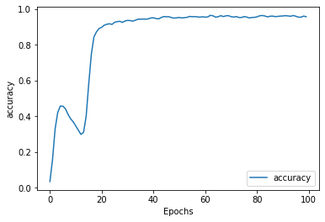
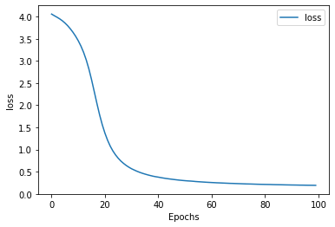
Results: Dense
The dense architecture achieved a final accuracy of 95.62%, and a final loss of 19.02%.

Slide 7
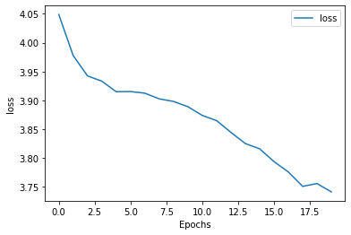
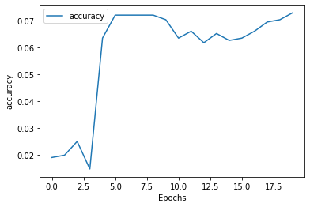
Results: GRU
The GRU architecture achieved a final accuracy of 7.3% and a final loss of 372.72%. Obviously this is horrendous. The current belief is that, due to the technical and uncommon nature of many of the text’s words, the pre-trained english model has difficulty learning from the selected text.

Slide 8
Question Answering
In only 3 of the 10 questions did the GRU model pick up one of the same sentences as the NN model, and in neither case wasthe GRU’s second selection in the NN’s selected sentences.
The GRU selected between 1 and 2 sentences, mostly only selecting one. It was noted that all of the sentence choices, regardless of the question, were one of two sentences. The current theory for this is that the model converged on two “summary” sentences and is fit such that those two sentences are the only options. Aka: we have major overfitting. It should also be noted that both sentences are better summaries than what was selected by the NLP class from the first section.

